Slide 1


Depression Detection on Twitter
Python Thinkers

Slide 2

Team Members
Anto Francis (C0825095)
Sachin Sreekumar (C0825096)
Omer Volkan Guney (C0831373)
Rupesh Chandran (C0826779)

Slide 3

Data Extraction from Twitter
Twint is used for data extraction.
Twint is a library used for extracting tweet information without using Twitter API
Data is extracted using keywords.
Can set the number of tweets extracted

Slide 4
Why Twint?
Scrape tweets without authentication and Twitter API
There is no limit on the data extracted from twitter compared to Twitter API.

Slide 5
Data Extraction
Using twint, tweets are scrapped from twitter.
We are taking 3 separate kind of data from the twitter:
Depressed data
Neutral data
Positive data.

Slide 6
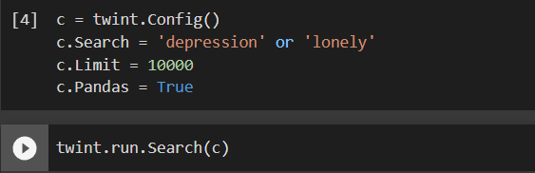
Depressed Data Extraction
Using twint, tweets with keywords depression, lonely are scrapped from twitter.
10,000 tweets

Slide 7
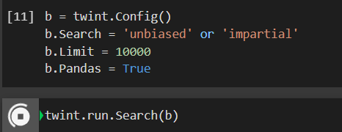
Neutral Data Extraction
Using twint, tweets with keywords unbiased, impartial are scrapped from twitter.
10,000 tweets

Slide 8
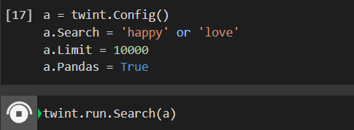
Positive Data Extraction
Using twint, tweets with keywords happy, love are scrapped from twitter.
10,000 tweets

Slide 9
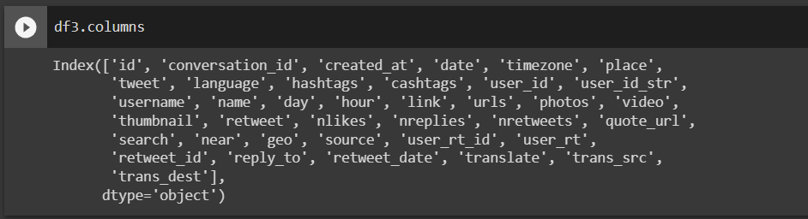
Dataset
We have three separate dataset: Depressed, Neutral and Positive.
These scrapped data is loaded into the respective dataset.
Dataset contains 40 attributes
Only id, date, tweet, and username is taken for analysis.
A target variable is defined as ‘0’ for depressed dataset, ‘2’ for neutral and ‘4’ for positive dataset.

Slide 10
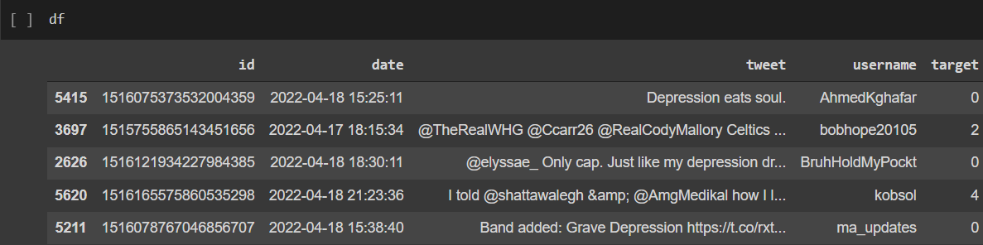
Final Dataset
Final dataset is obtained concatenating all the three datasets.
Data rows from different datasets are shuffled in the final dataset.
About 30000 rows of data.

Slide 11
Data Wrangling
Checking for null values.
Dropping rows having null values.
Converting date attribute into date time format for plotting.

Slide 12
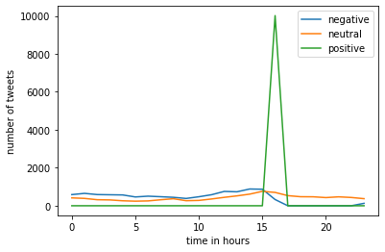
Exploratory Data Analysis
The target variable is visualised over the date time variable.
Line chart shows how the timings of the day results in the mood of the users.

Slide 13
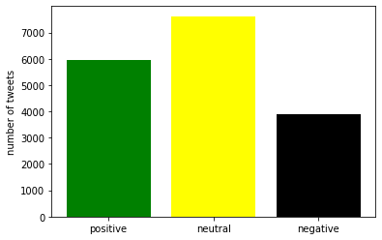
Exploratory Data Analysis Contd.
The behaviour of user tweets are analysed by using twitter handles.
Positive, neutral and depressed tweets are counted using the target variables and visualised.

Slide 14
Pre-processing of tweets
Removing html tags
<div> <h1>Title</h1> <p></p> </a> </div>
Removing twitter handles
Words starting with @
Removing Punctuations
, ‘ “” ? - _ : ;
Removing Stopwords
Removed common words using WordCloud’s STOPWORD

Slide 15
Pre-processing of tweets Contd.
Tokenization:
Words are tokenized using nltk.word_tokenize
Performing stemming:
Reduced to word’s base form using PorterStemmer()
Combining words together:
Small words, less than 3 are removed
Check for null values:
Removing data rows that have null values.

Slide 16
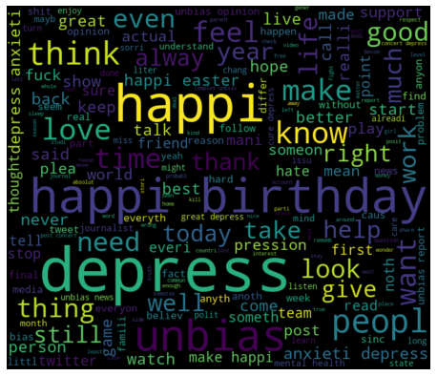
Word Cloud Visualization
After pre-processing of tweets, the cleaned tweets are visualised in the word cloud to see the most common words.
World cloud is visualised for each dataset: depressed, neutral, happy and the combined dataset.

Slide 17
Models
Support Vector Classifier
Naïve Bayes Classifier
SGD Classifier
Logistic Regression classifier
Random Forest Classifier

Slide 18
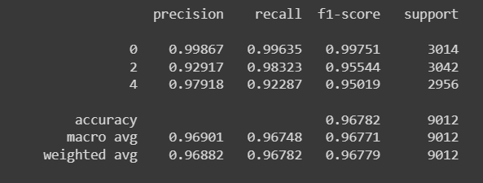
Support Vector Classifier
The baseline model of Support vector classifier has accuracy of 96.782%.
Multivariate classifier classifying positive, neutral and depressed tweets.

Slide 19
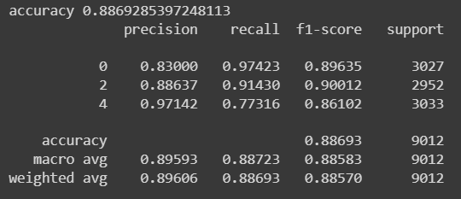
Naïve Bayes Classifier
Naïve Bayes classifier has accuracy of 88.692%.
Multivariate classifier classifying positive, neutral and depressed tweets.

Slide 20
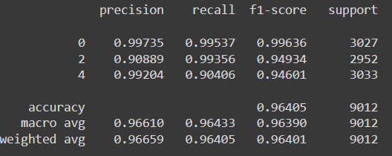
SGD Classifier
SGD Classifier has accuracy of 96.405%.
Multivariate classifier classifying positive, neutral and depressed tweets.

Slide 21
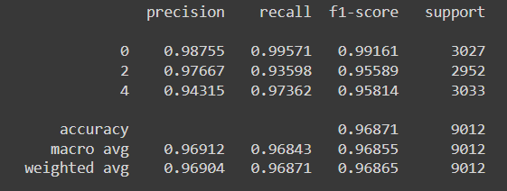
Logistic Regression Classifier
Logistic Regression classifier has accuracy of 96.871%.
Multivariate classifier classifying positive, neutral and depressed tweets.

Slide 22
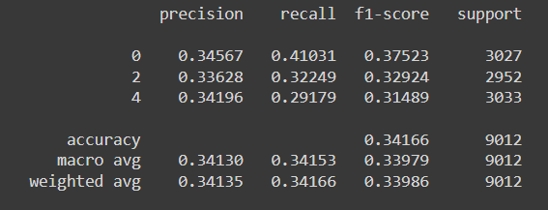
Random Forest Classifier
Random Forest classifier has accuracy of 34.166%.
Multivariate classifier classifying positive, neutral and depressed tweets.

Slide 23
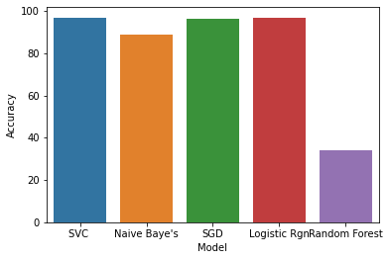
Comparison of Models
All the models used in the analysis are compared according to their accuracy.

Slide 24
Conclusion
Data is extracted from twitter using twint and loaded into the dataset.
Mainly three dataset: depressed, neutral and happy.
Exploratory data analysis
Pre-processing of tweets.
Model Building
Comparison of models.

Slide 25
Thank You

